Slide 1
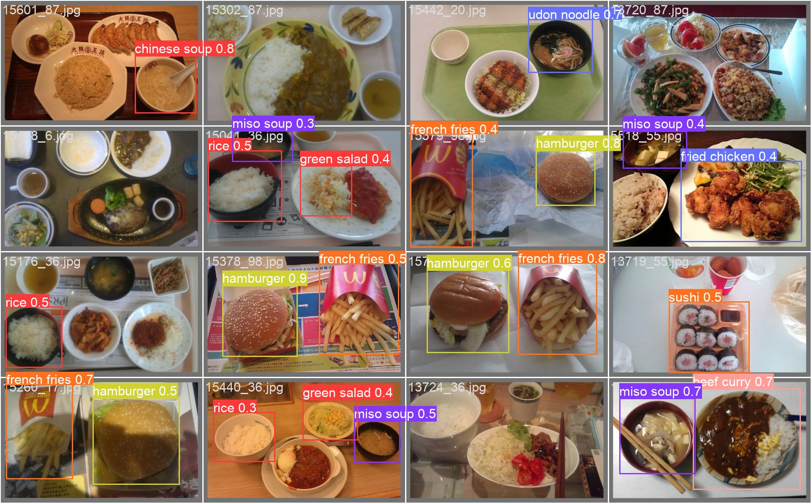
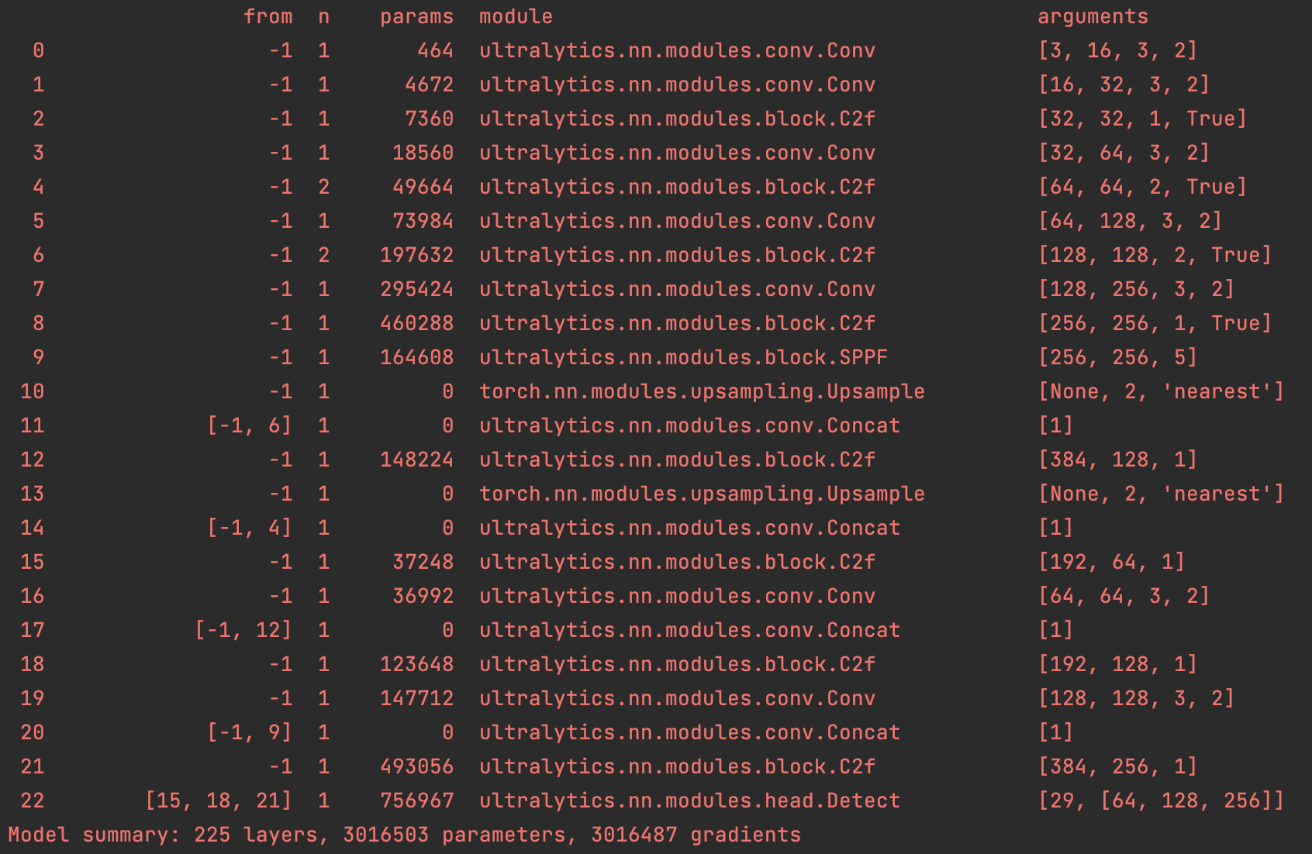
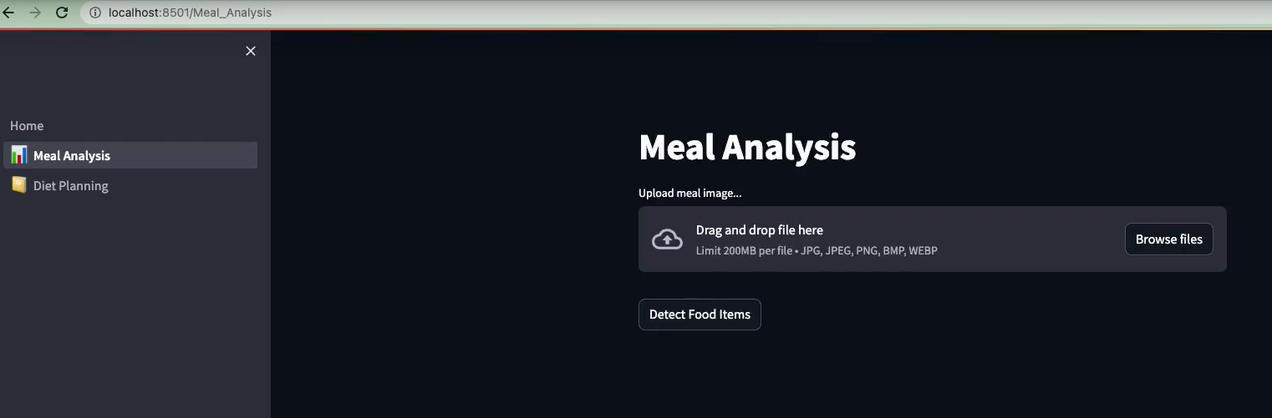
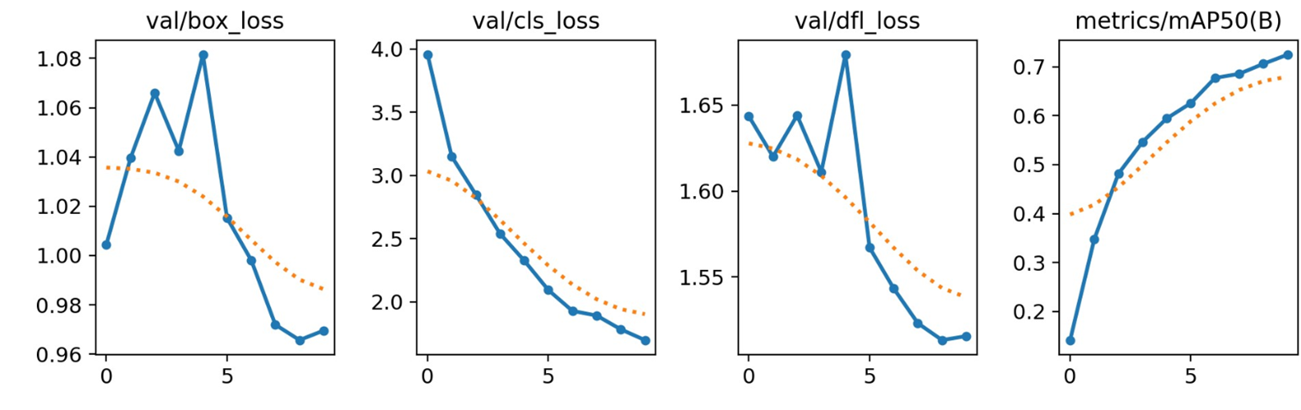
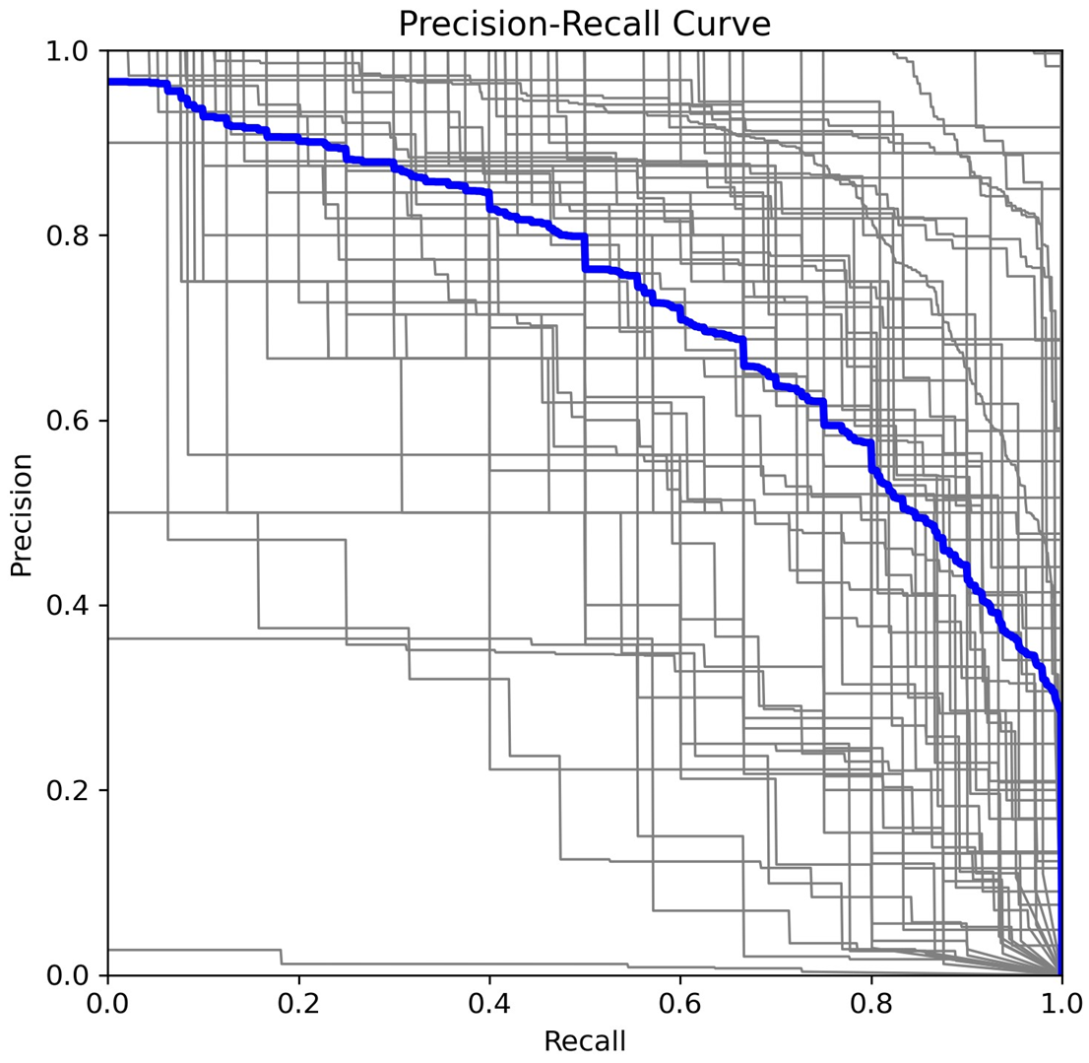
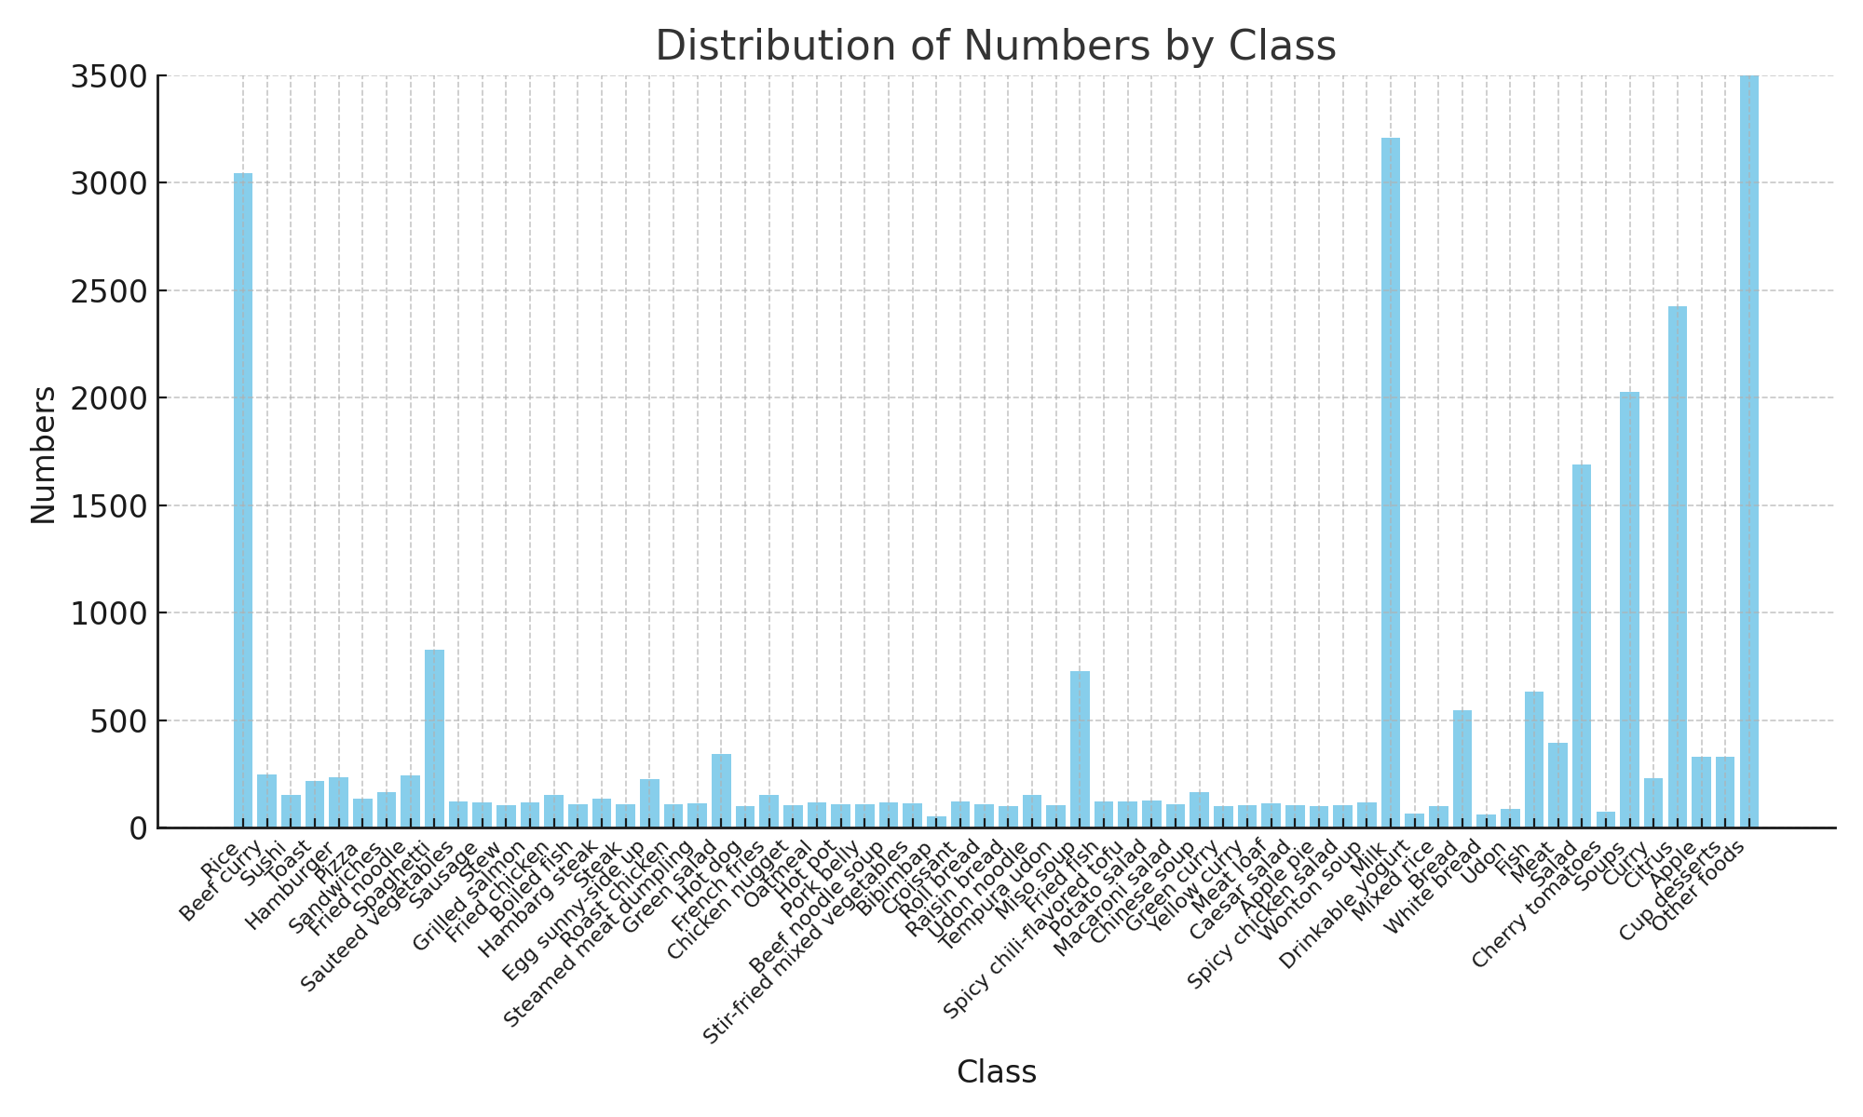
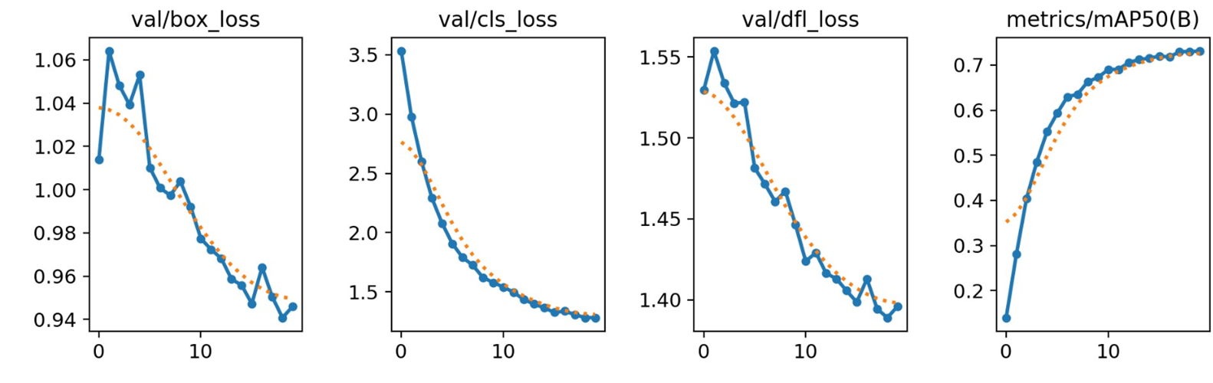

NutritionExpert
Members: Dana Lee, Dustin Tsai, Sunny Chin, Ting-Yu Lin Mentor: Eric Young
Introduction
Methodology and Results
Discussion and Conclusions
By harnessing the power of AI technologies, we aim to democratize personalized nutrition, making it available to individuals of all backgrounds and lifestyles.
Meal Analysis: We selected YOLOv8 for training on the UECFOOD-256 and School Lunch datasets and integrated the CalorieNinjas API to provide the nutritional information of each detected food item.
Diet Planning: We leveraged the capabilities of GPT-4 through the OpenAI API to generate personalized diet plans.
YOLOv8 is a state-of-the-art object detection model that is known for its fast detection speed while maintaining high accuracy, making it suitable for detecting food items in real-time.
Our model’s backbone contains a series of convolutional layers that extract relevant features from the input image
Integration with Calorie Ninjas API, GPT-4, and Streamlit allows for efficient and user-friendly personalized nutrition analysis and diet planning.
Food Detection
Dataset and Data Preprocessing
The datasets used in our project are UECFOOD-256 and school lunch available at
http://foodcam.mobi/dataset.html
Food photos annotated with bounding boxes coordinates.
276 categories, predominantly Japanese cuisine, and 65 categories selected for training.
Data pre-processing:
Split each label into individual .txt file for YOLO format.
Perform data normalization and data cleaning through overwriting the existing file with the identical filename.
Data split: Train:Val = 9:1
Most food items could be accurately detected with accurate labels and bounding boxes (mAP ~73%).
Food items that were partially cut off on the edges of some images were frequently labeled incorrectly.
Different model settings and hyperparameters have been explored.
(UECFOOD256)
(10 epochs / 80% train - 10% val - 10% test / λ = 5e-4)
Future Work
P-R Curve
Larger datasets
– Increase the number of categories and images
Handling balanced data
– Balance the number of images across different classes
Weight measurements
– Try methods to get volume and weights of food
Hyperparameters tuning
(20 epochs / 90% train - 10% val / λ = 0.03)
(UECFOOD256+school_lunch)

